Slide 1
Magic Fractions
nRich – cannot find url

Slide 2

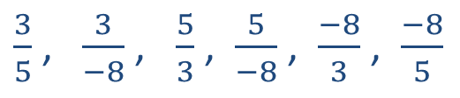
Magic Fractions
Choose three, different, non-zero integers that sum to zero.
Form all the possible ordered pairs you can with these numbers (you should get six)
Turn all of these into fractions using the first number as the numerator and the second as the denominator.
Sum all of these fractions.
Find the product of all of these fractions.
Can you prove any findings you make?
e.g. $3$, $5$, $−8$
$3,5$ $3,−8$ $5,3$ $5,−8$ $−8,3$ $−8,5$
$\frac{3}{5}$ , $\frac{3}{−8}$ , $\frac{5}{3}$ , $\frac{5}{−8}$ , $\frac{−8}{3}$ , $\frac{−8}{5}$

Slide 3
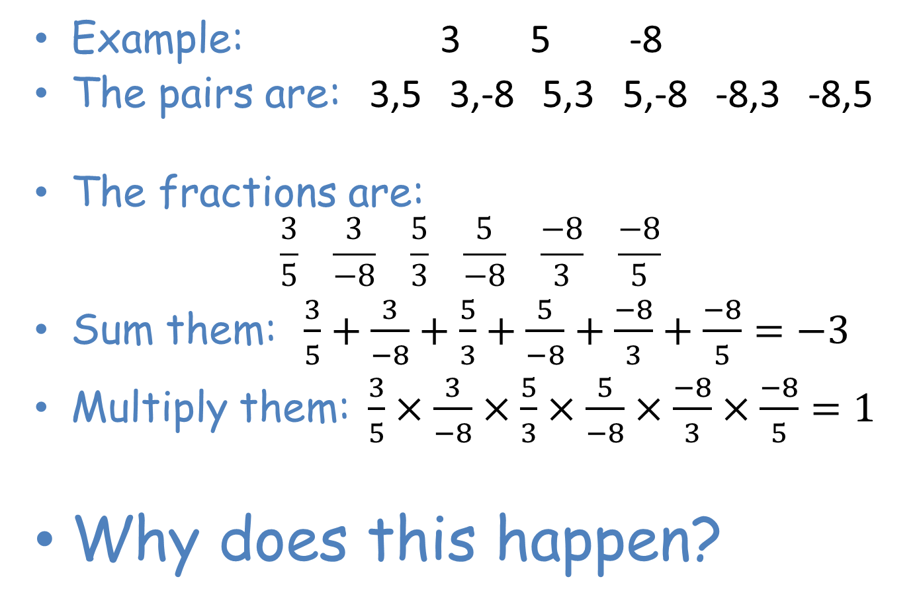
Magic Fractions
Example: 3 5 -8
The pairs are: 3,5 3,-8 5,3 5,-8 -8,3 -8,5
The fractions are:
$\frac{3}{5} \frac{3}{−8} \frac{5}{3} \frac{5}{−8} \frac{−8}{3} \frac{−8}{5}$
Sum them: $\frac{3}{5}+\frac{3}{−8}+\frac{5}{3}+\frac{5}{−8}+\frac{−8}{3}+\frac{−8}{5}=−3$
Multiply them: $\frac{3}{5}×\frac{3}{−8}×\frac{5}{3}×\frac{5}{−8}×\frac{−8}{3}×\frac{−8}{5}=1$
Why does this happen?

Slide 4
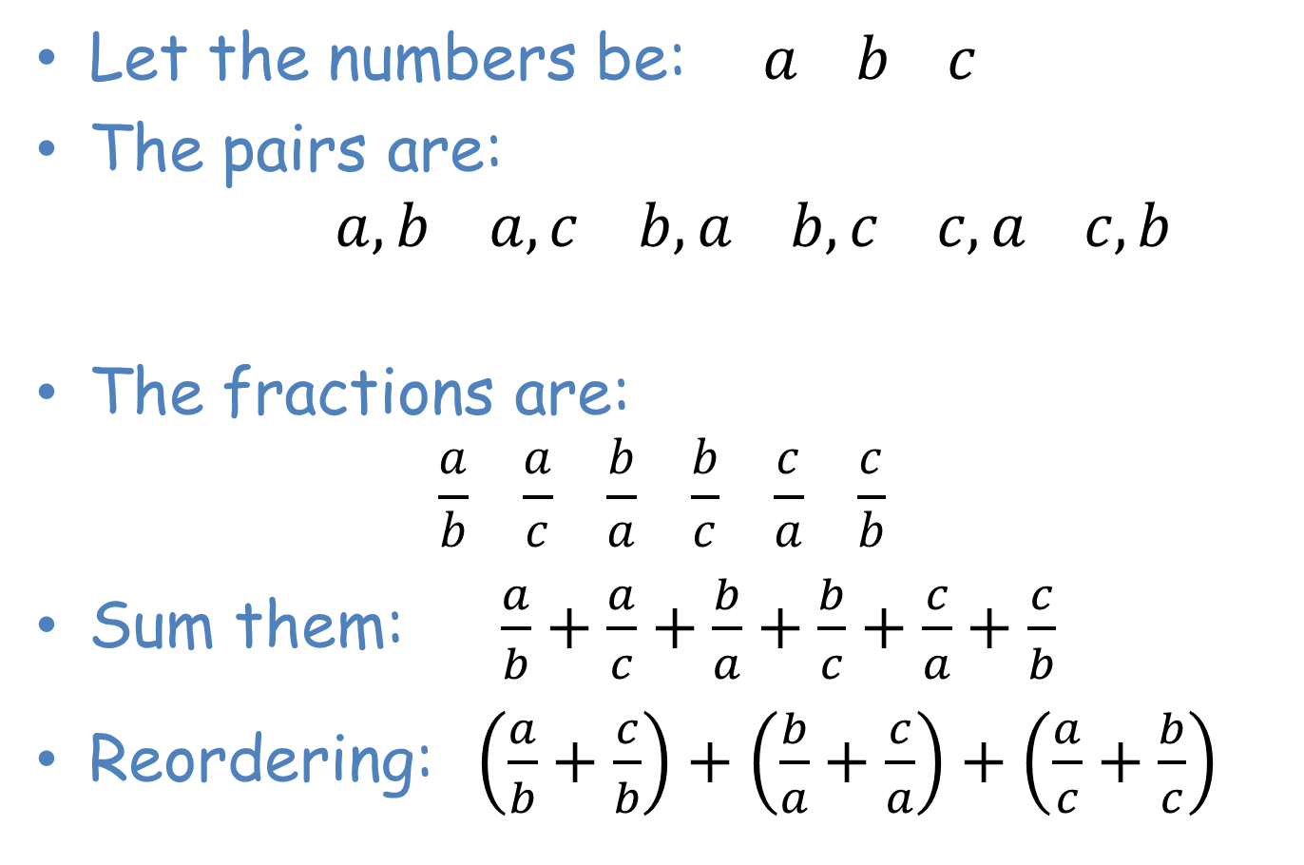
Magic Fractions
Proof
Let the numbers be: $a b c$
The pairs are:
$a,b$ $a,c$ $b,a b,c c,a c,b$
The fractions are:
$\frac{a}{b} \frac{a}{c} \frac{b}{a} \frac{b}{c} \frac{c}{a} \frac{c}{b}$
Sum them: $\frac{a}{b}+\frac{a}{c}+\frac{b}{a}+\frac{b}{c}+\frac{c}{a}+\frac{c}{b}$
Reordering: $\left(\frac{a}{b}+\frac{c}{b}\right)+\left(\frac{b}{a}+\frac{c}{a}\right)+\left(\frac{a}{c}+\frac{b}{c}\right)$

Slide 5
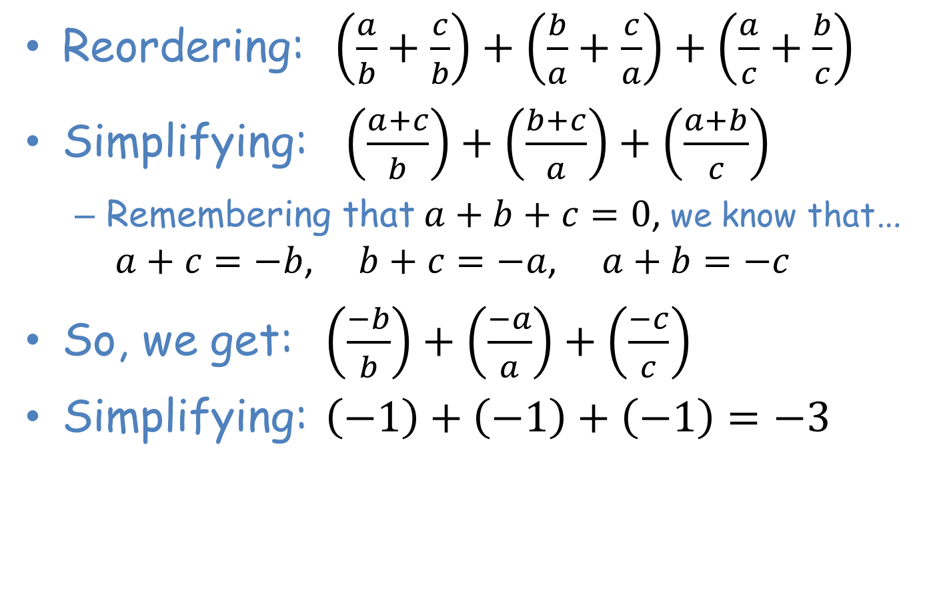
Magic Fractions
Proof
Reordering: $\left(\frac{a}{b}+\frac{c}{b}\right)+\left(\frac{b}{a}+\frac{c}{a}\right)+\left(\frac{a}{c}+\frac{b}{c}\right)$
Simplifying: $\left(\frac{a+c}{b}\right)+\left(\frac{b+c}{a}\right)+\left(\frac{a+b}{c}\right)$
  Remembering that $a+b+c=0$, we know that…
  $a+c=−b$, $b+c=−a$, $a+b=−c$
So, we get: $\left(\frac{−b}{b}\right)+\left(\frac{−a}{a}\right)+\left(\frac{−c}{c}\right)$
Simplifying: $\left(−1\right)+\left(−1\right)+\left(−1\right)=−3$

Slide 6
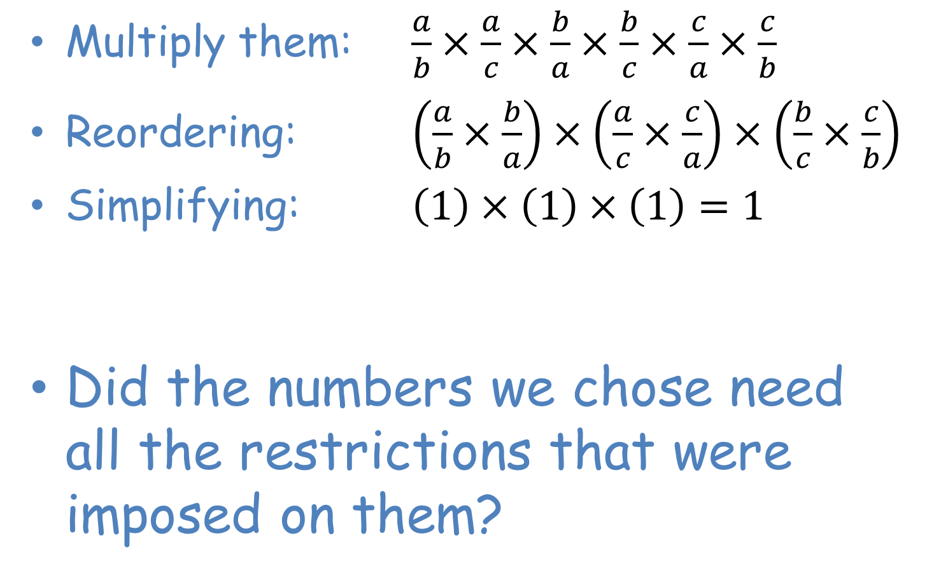
Magic Fractions
Proof
Multiply them: $\frac{a}{b}×\frac{a}{c}×\frac{b}{a}×\frac{b}{c}×\frac{c}{a}×\frac{c}{b}$
Reordering: $\left(\frac{a}{b}×\frac{b}{a}\right)×\left(\frac{a}{c}×\frac{c}{a}\right)×\left(\frac{b}{c}×\frac{c}{b}\right)$
Simplifying: $\left(1\right)×\left(1\right)×\left(1\right)=1$
Did the numbers we chose need all the restrictions that were imposed on them?
Notes:
Did they need to be integers? Did they have to be different? They had to be non-zero and sum to zero.

